Slide 1

GitPet
Ambient DevSecOps Repository Companion
DEVOPS FOR GENAI 2026
TEAM 05
See risk. Understand evidence.
Resolve safely.
Aliasgar Husain • Lucas Whitaker
David Castelli • Faris Nour
Notes:
Introduce GitPet and frame the three pain points: fragmented context, excessive AI agency, and inaccessible Git and pipeline telemetry. [Sources] User-provided FEATURES.md, PRESENTATION_SLIDES.md, and SLIDE_NOTES.md.

Slide 2
SOLUTION
Notice • Understand • Resolve
Byte turns repository telemetry into an actionable DevSecOps loop.
2
UNDERSTAND
3
RESOLVE
1
NOTICE
Multimodal Gemini reasoning explains issues in plain language.
Surfaces concrete evidence signals (branch divergence, dirty files, conflict markers, CVE IDs).
Delivers explicit confidence ratings (%), 4-tier risk badges, and deterministic reversal steps.
Bounded, reversible Git actions with mandatory human-in-the-loop preview.
Zero blind execution: modal diff preview reveals blast radius, affected files, and exact argv parameters.
One-click rollback restores working tree state safely using pre-computed undo commands.
Byte's posture, mood aura, and chiptune audio cues reflect repository health at a glance
8 expressive symptom map 1:1 to Git status, CI/CD pipeline states, PR bottlenecks, and cloud infrastructure alerts.
Notes:
Explain that Byte is a real-time visualization of repository posture, not decorative branding. [Sources] User-provided FEATURES.md, PRESENTATION_SLIDES.md, and SLIDE_NOTES.md.

Slide 3
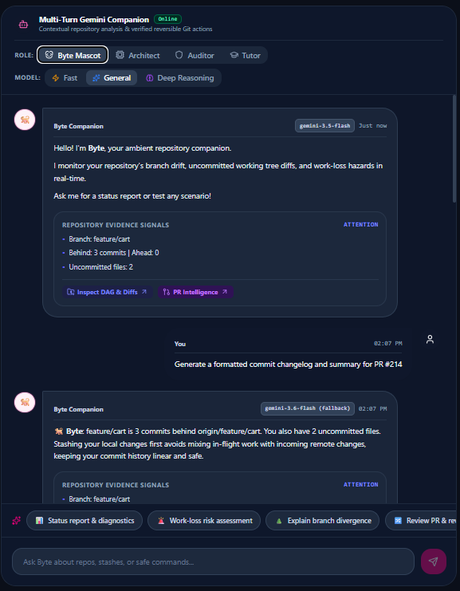
AI ASSISTANCE
Talk to Byte: multi-persona guidance
Four roles, three model tiers, and structured responses tied to repository evidence.
MODEL TIERS
• Fast: instant status checks
• General: chat and repository analysis
• Deep: multi-branch conflicts and architecture
EVERY RESPONSE INCLUDES
• Evidence signals and confidence
• Risk badge and expected impact
• Safe action, reversal, preview and approval
Notes:
Demo Behind Main, ask for a status report, then point to evidence, confidence, risk, and the reversal command. [Sources] User-provided FEATURES.md, PRESENTATION_SLIDES.md, and SLIDE_NOTES.md.

Slide 4
SAFETY
Bounded agency: the code-level guarantee
The model can suggest. The safety engine decides what is allowed.
LAYER 1 STATIC RULES
Threat Code | Blocked Pattern | Code-Level Defense | Safe Alternative
force-push | git push --force, -f | Hard-rejected by regex tokenizer | git push --force-with-lease
hard-reset | git reset --hard | Destructive working tree wipe blocked | git reset --keep / git stash
clean-wipe | git clean -fdx | Permanent file deletion blocked | Stash or manual file review
force-branch-delete | git branch -D | Unmerged branch deletion blocked | git branch -d (safe check)
stash-destroy | git stash drop, clear | History destruction blocked | Explicit stash pop/apply only
remote-ref-delete | git push origin --delete | Remote branch deletion blocked | Handled via PR web interface
history-rewrite | filter-branch, filter-repo | Repository history mutation blocked | Protected Git operations
shell-injection | ;, |, &, >, <, $(), ` | Metacharacters stripped/rejected | Argv array tokenization
non-git-binary | sudo, rm, curl, sh | Binary whitelist (git only) | Rejected at gateway router
Notes:
Show Preview Changes. Mention blast radius, affected files, explicit confirmation, and deterministic reversal. [Sources] User-provided FEATURES.md, PRESENTATION_SLIDES.md, and SLIDE_NOTES.md.

Slide 5
SAFETY
Bounded agency: the code-level guarantee
The model can suggest. The safety engine decides what is allowed.
LAYER 2 CONTEXTUAL LINTS
Lint Identifier | Repository Context Detected | Prevented Failure | Safe Recommendation
stash-misses-untracked | Working tree contains untracked files | Untracked files left behind on stash | Suggests git stash push -u
push-while-behind | Branch is behind remote (behind >= 1) | Remote rejects non-fast-forward push | Suggests git pull --rebase first
diverged-pull-needs-rebase | Local and remote branches diverged | Unintended merge commit pollution | Suggests git pull --rebase origin main
operation-in-progress | Active rebase/merge lock files present | Corrupted intermediate Git state | Limits commands to --continue, --skip, --abort
stash-pop-empty | Stash stack length == 0 | Confusing "No stash entries found" error | Blocks empty stash pop
dirty-tree-checkout | Uncommitted edits on branch switch | Accidental overwrite of active work | Prompts to stash or commit first
Notes:
Show Preview Changes. Mention blast radius, affected files, explicit confirmation, and deterministic reversal. [Sources] User-provided FEATURES.md, PRESENTATION_SLIDES.md, and SLIDE_NOTES.md.

Slide 6
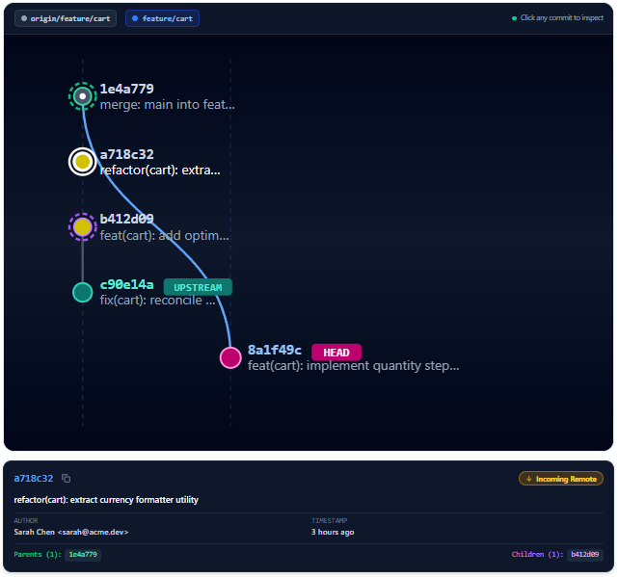
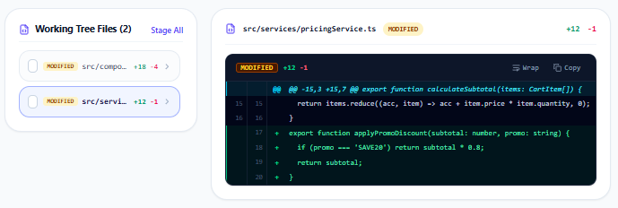
REPOSITORY
See Git topology, diffs, stashes, and history
The repository workspace makes branch state and file changes understandable.
MULTI-LANE DAG
WORKING TREE
Notes:
Navigate the DAG, inspect a commit, then show diffs, staging controls, stashes, and rollback history. [Sources] User-provided FEATURES.md, PRESENTATION_SLIDES.md, and SLIDE_NOTES.md.

Slide 7
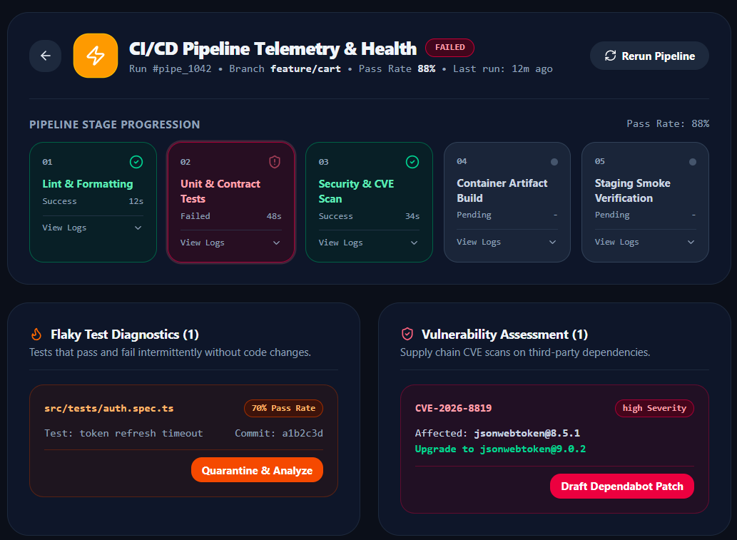
CI/CD
From pipeline failure to remediation
Track stages, inspect logs, quarantine flaky tests, and address vulnerable dependencies.
EXPANDABLE LOGS
FAIL auth.spec.ts
token refresh timeout
1 test failed in 48s
SUPPLY CHAIN
• CVE severity and version
• Exact safe target version
• Draft Dependabot patch
FLAKY TESTS
• Pass rate and recent failures
• Last failing commit
• Quarantine & Analyze
Notes:
Use the build-failure scenario. Show the failed stage, terminal logs, flaky test diagnostics, and CVE remediation. [Sources] User-provided FEATURES.md, PRESENTATION_SLIDES.md, and SLIDE_NOTES.md.

Slide 8
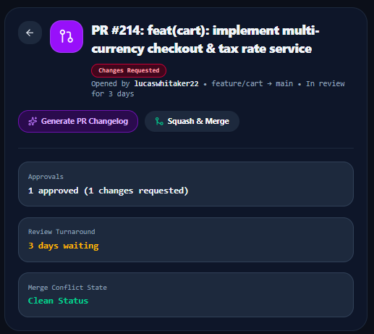
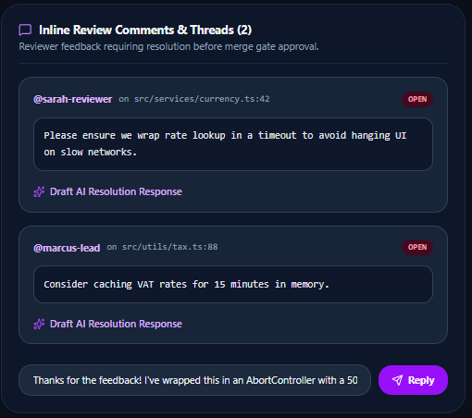
PULL REQUESTS
From blocked review to merge readiness
Unify approvals, turnaround, inline threads, and AI-assisted resolution.
Notes:
Show PR #214, review metrics, the file-linked comment, and the one-click AI resolution response. [Sources] User-provided FEATURES.md, PRESENTATION_SLIDES.md, and SLIDE_NOTES.md.

Slide 9
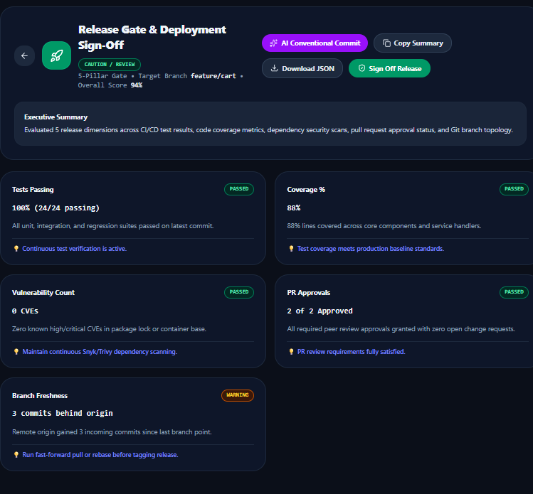
SCORING
Release Gate + Deployment
Deployment readiness and repository health stay aligned with Byte’s visual state.
HEALTH FACTORS
• Branch divergence
• Failed and flaky tests
• Secrets and security policies
• Open vulnerabilities
• Code smells and debt
• Unreviewed commits and PR lag
• Large PR size
68
ATTENTION HP
Score = max(0, 100 − deductions)
Notes:
Show the five weighted release pillars, active blockers, exports, then the seven risk factors and Remediate with Byte. [Sources] User-provided FEATURES.md, PRESENTATION_SLIDES.md, and SLIDE_NOTES.md.

Slide 10
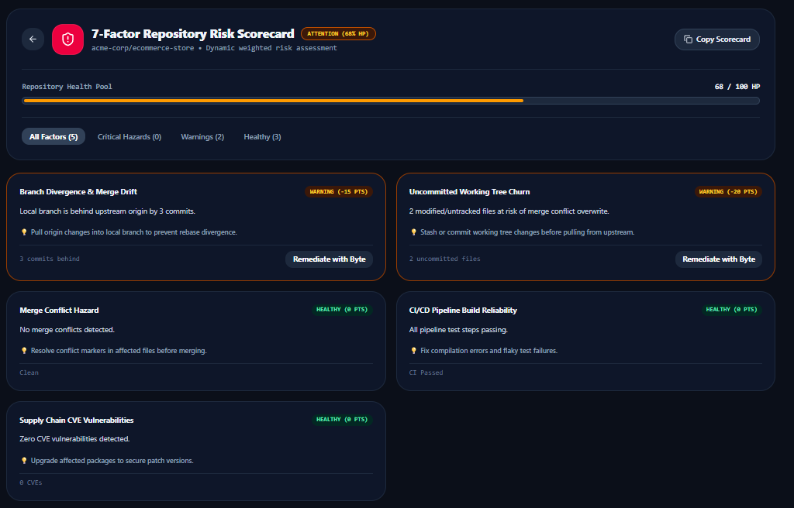
SCORING
Risk Analysis
Dynamic weighted risk assessment
Notes:
Show the five weighted release pillars, active blockers, exports, then the seven risk factors and Remediate with Byte. [Sources] User-provided FEATURES.md, PRESENTATION_SLIDES.md, and SLIDE_NOTES.md.

Slide 11
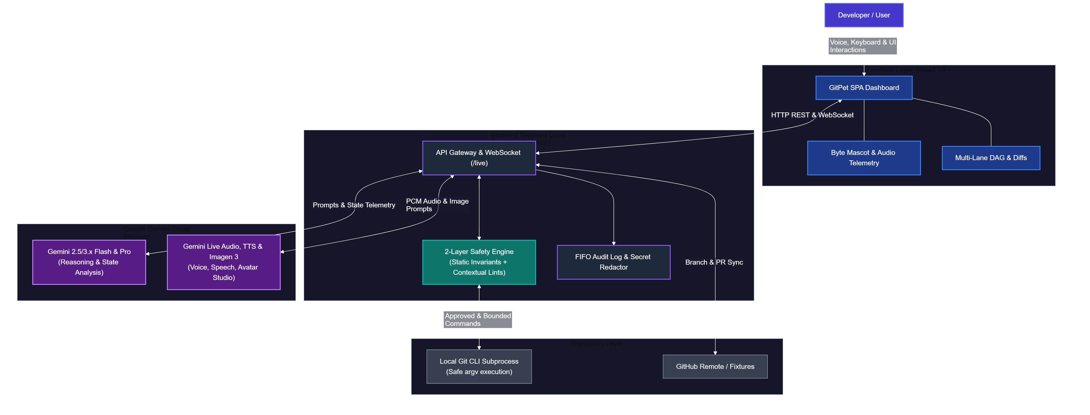
ARCHITECTURE
React 19 + Express gateway + Gemini services
A production-shaped separation between interface, policy, execution, and external services.
Notes:
Emphasize that the gateway prevents AI output from becoming a direct shell command and manages secrets, validation, audit, and execution. [Sources] User-provided FEATURES.md, PRESENTATION_SLIDES.md, and SLIDE_NOTES.md.

Slide 12
GitPet makes DevSecOps health
ambient, explainable, and safely actionable.
AMBIENT AWARENESS
BOUNDED AGENCY
MULTIMODAL AI
No terminal hunting
Safety enforced in code
Text, voice, image, TTS
DEVSECOPS INTELLIGENCE
PRODUCTION READY
Team Ribbon Patrol
DAG, CI/CD, PR, release
Tests, governance, SBOM, runbook
Aliasgar Husain • Lucas Whitaker
David Castelli • Faris Nour
PRESS P FOR IN-APP DECK
npm run dev → http://localhost:3004
Notes:
Close with the core message: GitPet keeps the developer in control. Mention AI-use transparency and invite the judges to try the live application. [Sources] User-provided FEATURES.md, PRESENTATION_SLIDES.md, and SLIDE_NOTES.md.

